Slide 1
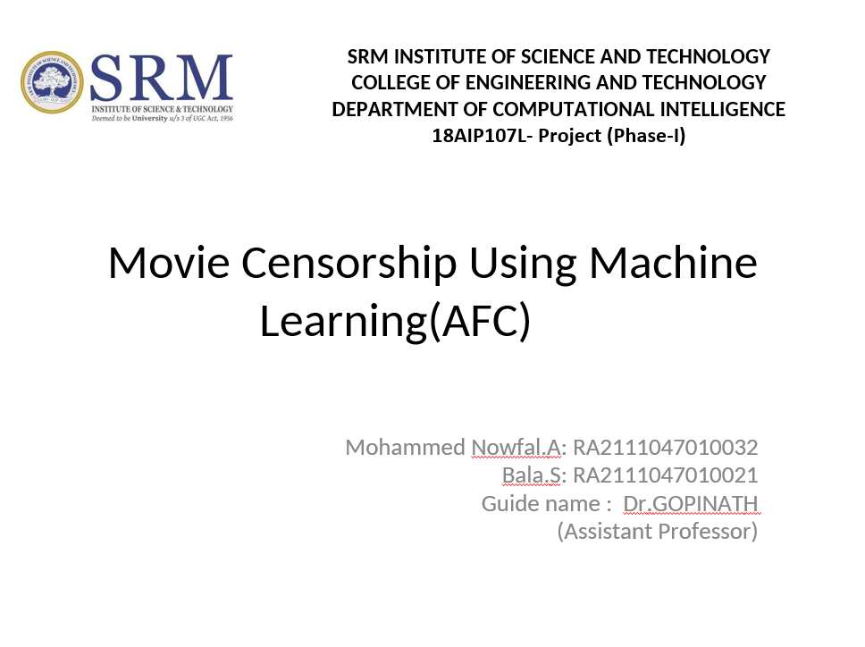

Slide 2
MOVIE CENSOR USING MACHINE LEARNING TECHNIQUES (AFC)
GUIDED BY –Dr.Gopinath
Presentation by Your
Mohammed Nowfal.A[RA2111047010032
Bala.S[RA2111047010021]
August - 2024

Slide 3

Introduction to Movie Censorship
Importance in Film Industry
Significance
Movie censorship plays a significant role in safeguarding cultural sensitivities, protecting viewers, and maintaining ethical boundaries in film content creation. It shapes the narrative and ensures films align with acceptable norms.
Exploring movie censorship is essential as it influences viewers' experiences, shapes industry practices, and reflects the evolving landscape of societal values and beliefs in the cinematic realm.
Contextualize Movie Censorship
Movie censorship is the process of restricting or limiting certain content in films to comply with societal standards or legal requirements. Understanding movie censorship is crucial to grasp its impact on storytelling and audience perception.

Slide 4

Current Challenges in Movie Censorship
Limitations of Traditional Methods
Traditional movie censorship methods face challenges in keeping pace with rapidly changing content trends, cultural shifts, and the diverse preferences of global audiences. These methods often struggle to effectively address nuanced content issues and emerging forms of expression.

Slide 5


Machine Learning in Censorship
Technological Advancements
Incorporating machine learning in censorship processes enables sophisticated content analysis, real-time decision-making, and personalized filtering mechanisms. This shift offers a more nuanced approach to content evaluation, addressing complex narrative elements and societal sensitivities.
Revolutionizing Movie Censorship
Machine learning technologies have the potential to revolutionize movie censorship by enabling automated, efficient, and scalable content evaluation. These advancements can enhance accuracy, consistency, and adaptability in censoring diverse content formats.

Slide 6
Benefits of AFC in Movie Censorship
Advantages of Automated Film Classification (AFC)
Enhanced Efficiency and Accuracy
Scalability and Consistency
Adaptability to Cultural Nuances

Slide 7

Implementation of Machine Learning Models
Ethical and Legal Considerations
Addressing ethical dilemmas, bias mitigation, transparency in decision-making, and regulatory compliance are critical aspects of deploying machine learning models in movie censorship. Striking a balance between innovation and responsible use is key to fostering trust and credibility.
Practical Implementation Steps
Implementing machine learning models in movie censorship involves data collection, model training, validation testing, and integration into existing censorship frameworks. Collaboration between data scientists, film experts, and regulatory bodies is vital for successful deployment.

Slide 8
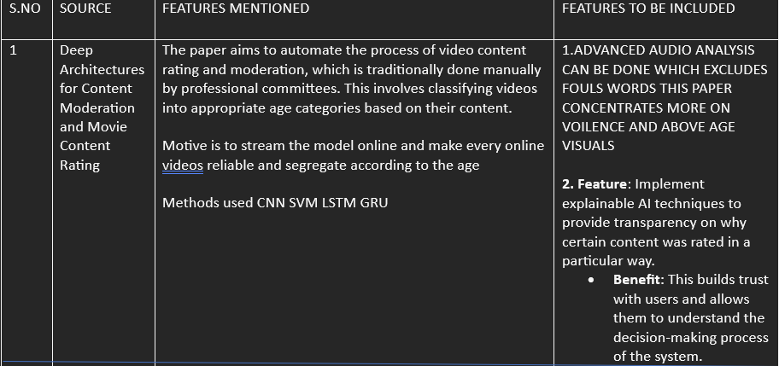

Slide 9
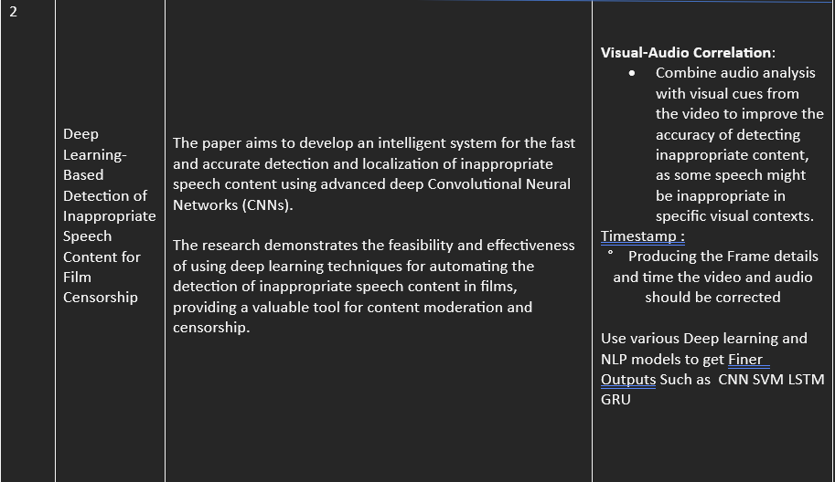

Slide 10
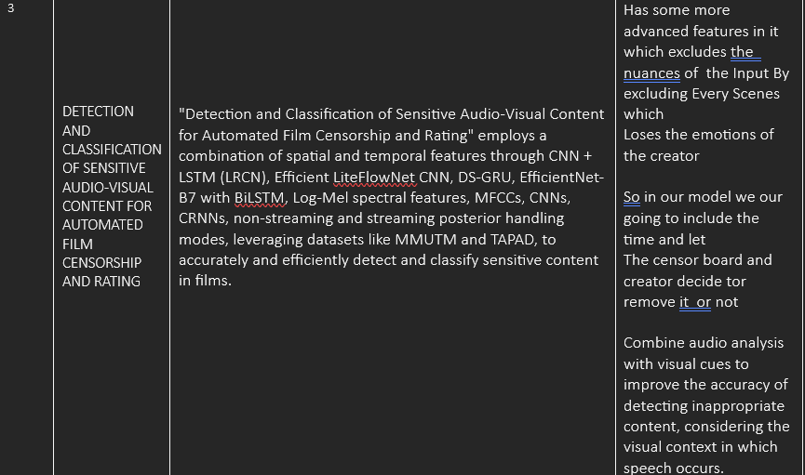

Slide 11
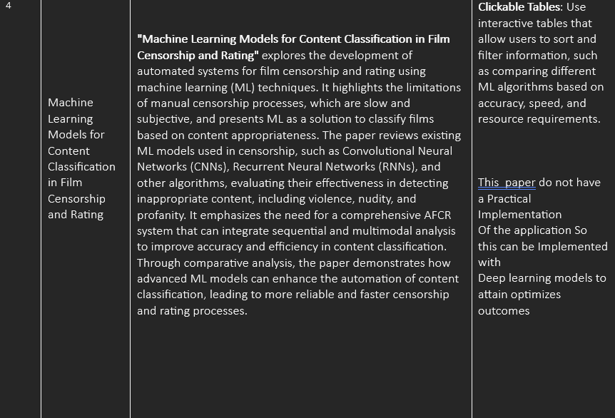

Slide 12
CNN&LSTM
CNN
Introduction:
CNNs are deep learning algorithms used for visual data analysis.
Key Components:
Convolutional Layers: Create feature maps from images.
Pooling Layers: Reduce dimensionality and improve robustness.
Fully Connected Layers: Combine features for predictions.
Advantages:
Learns features directly from images.
Captures spatial relationships.
Efficient with shared weights.
Applications in AFCR:
Frame Classification: Identifies sensitive content like blood or nudity.
Feature Extraction: Provides input for temporal analysis by LSTMs.
LSTM
Long Short-Term Memory (LSTM) Networks
Introduction:
LSTMs are RNNs designed to capture long-term dependencies in sequences.
Key Components:
Memory Cell: Stores information over time.
Gates: Controls input, output, and forgetting of information.
Advantages:
Handles long sequences effectively.
Selectively remembers important information.
Versatile for various sequence prediction tasks.
Applications in AFCR:
Temporal Analysis: Understands context and transitions between frames.
Contextual Understanding: Enhances frame classification accuracy.
Combination with CNNs: Uses CNN-extracted features for temporal analysis
This Photo by Unknown Author is licensed under CC BY-SA-NC

Slide 13

Novelty
The Automated Film Censorship and Rating (AFCR) project aims to develop an advanced system that automatically detects and censors inappropriate content in films using state-of-the-art machine learning models. The system will identify and mark timestamps for occurrences of profanity, nudity, and violence, providing detailed reports for content moderators. The novelty of this project lies in its comprehensive and real-time analysis of both visual and audio components, context-aware detection capabilities, and multi-language support, ensuring accurate and efficient content moderation across diverse media platforms.
This Photo by Unknown Author is licensed under CC BY-SA

Slide 14
Future of Movie Censorship with AFC
50%
30%
20%
Global Standardization
Efficiency and Accuracy
Adaptability to Content Variety
Machine learning advancements are projected to enhance the efficiency and accuracy of movie censorship processes, leading to more effective content evaluations and timely decision-making.
Automated film classification systems may contribute to global standardization of censorship practices, harmonizing content regulations across borders and accommodating diverse cultural sensitivities.
Machine learning algorithms in movie censorship can adapt to a wide range of content types, genres, and languages, enabling more comprehensive and nuanced evaluations to cater to diverse audience preferences.

